Slide 1
Q. Can Alzheimer’s disease be confirmed in the living patient?

Slide 2
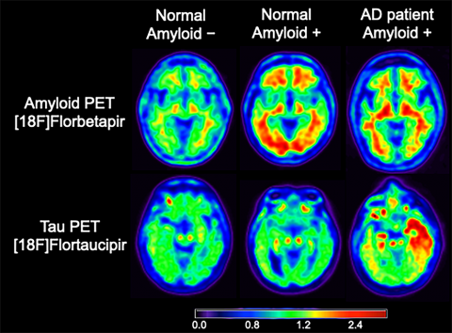
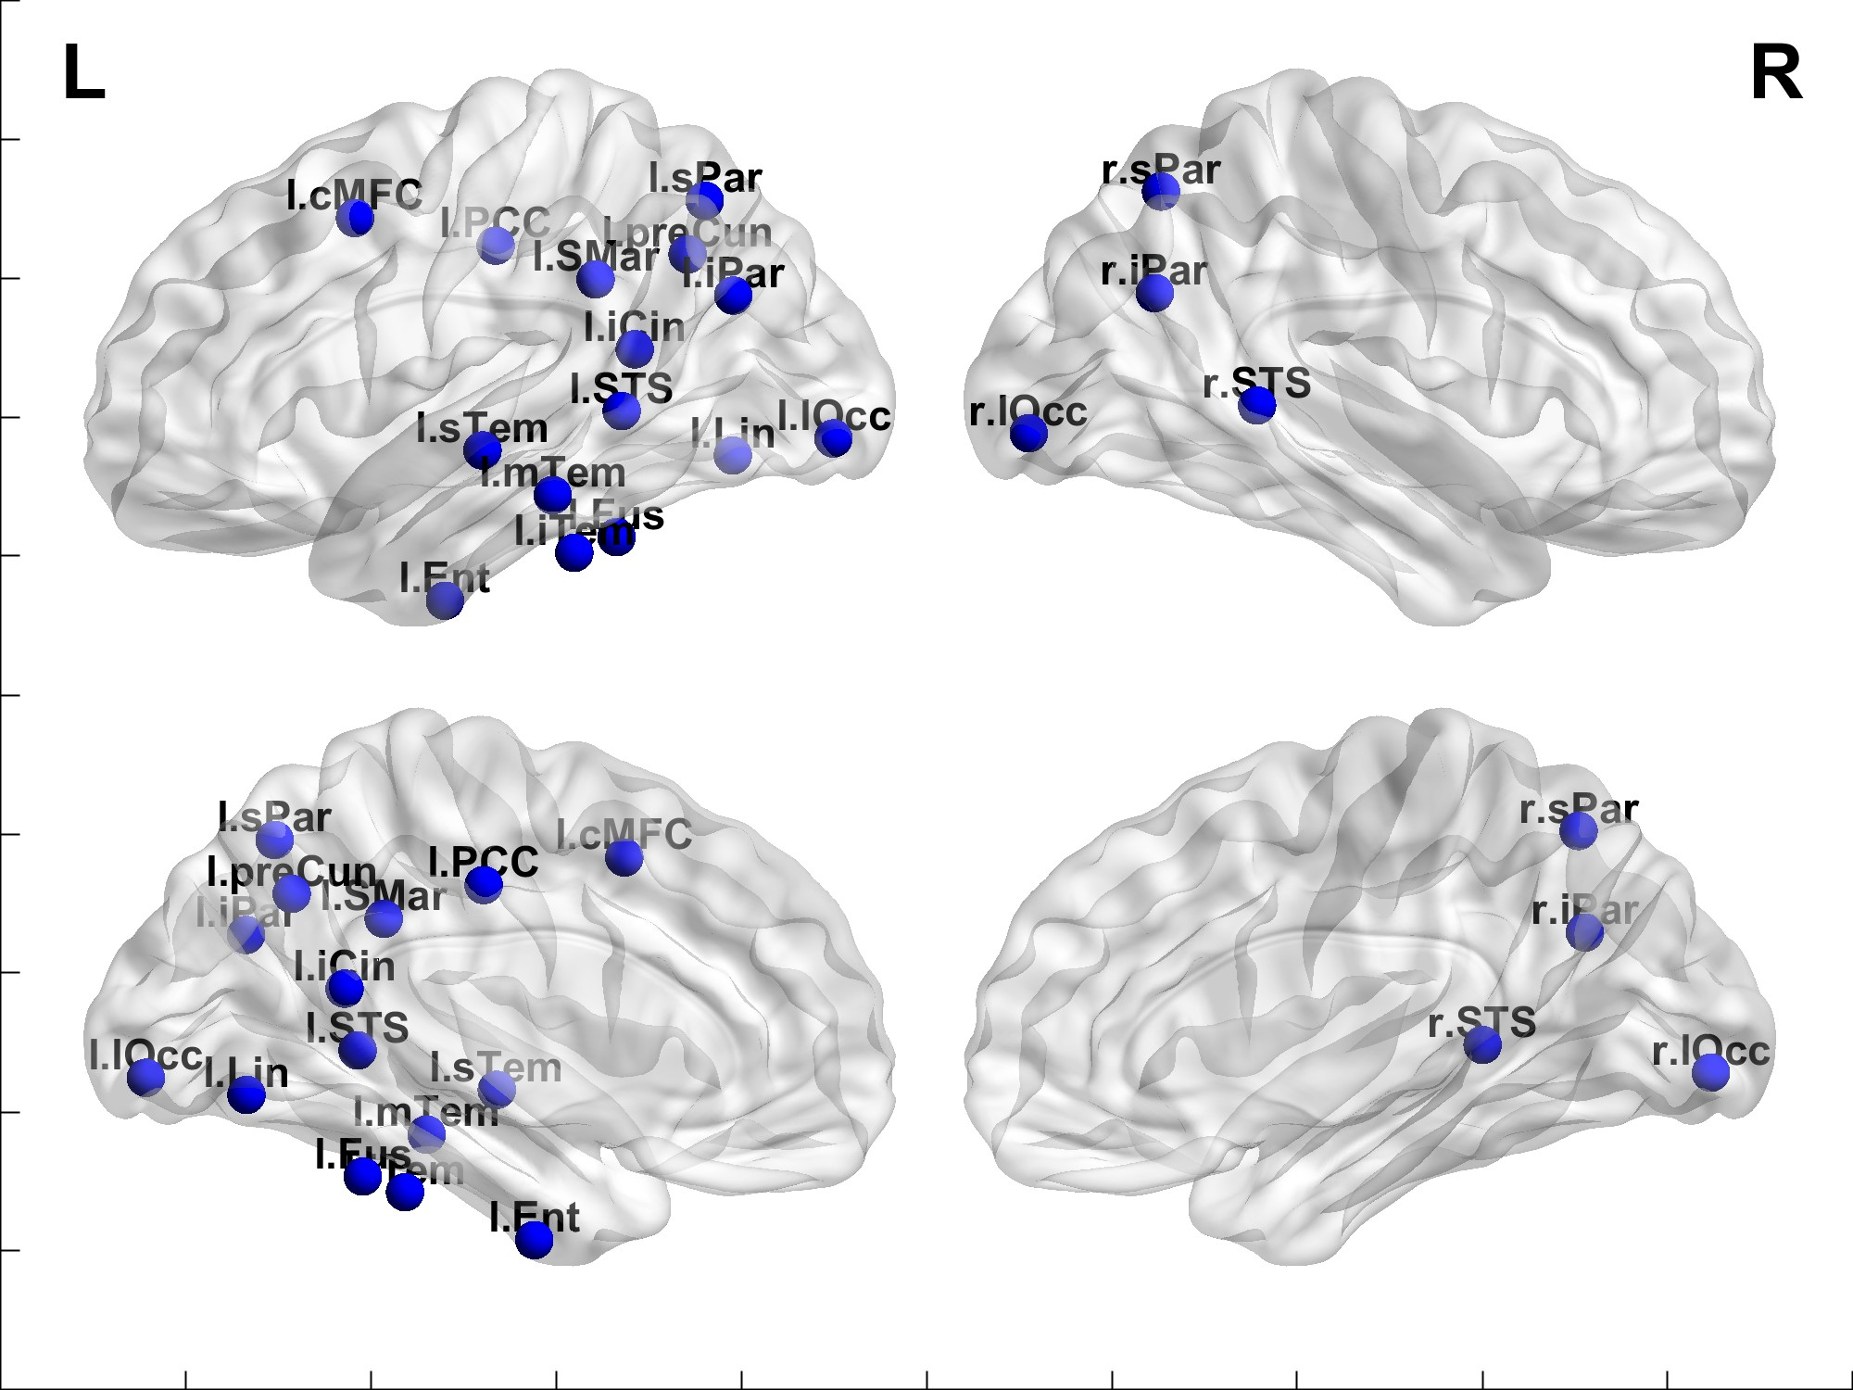
Cognitive testing, vMRI and Molecular imaging
The 3 neuropsychological profiles of AD: typical, PCA and Logopenic aphasia

